Slide 1




VSU and VCS Transformation Plan
for the
Branch Alliance for Educator Diversity Partnership Grant
2023-2025

Slide 2


Grant Leadership Team
Elizabeth Lisic
Sedef Smith
David Slykhuis
Natalie Kuhlmann
Kristy Litster
Regina L. Suriel
Forrest Parker
David Cole
April Doyle
Joyce Dean
Alex Alvarez
Royce Thomas
LaConya McCrae

Slide 3
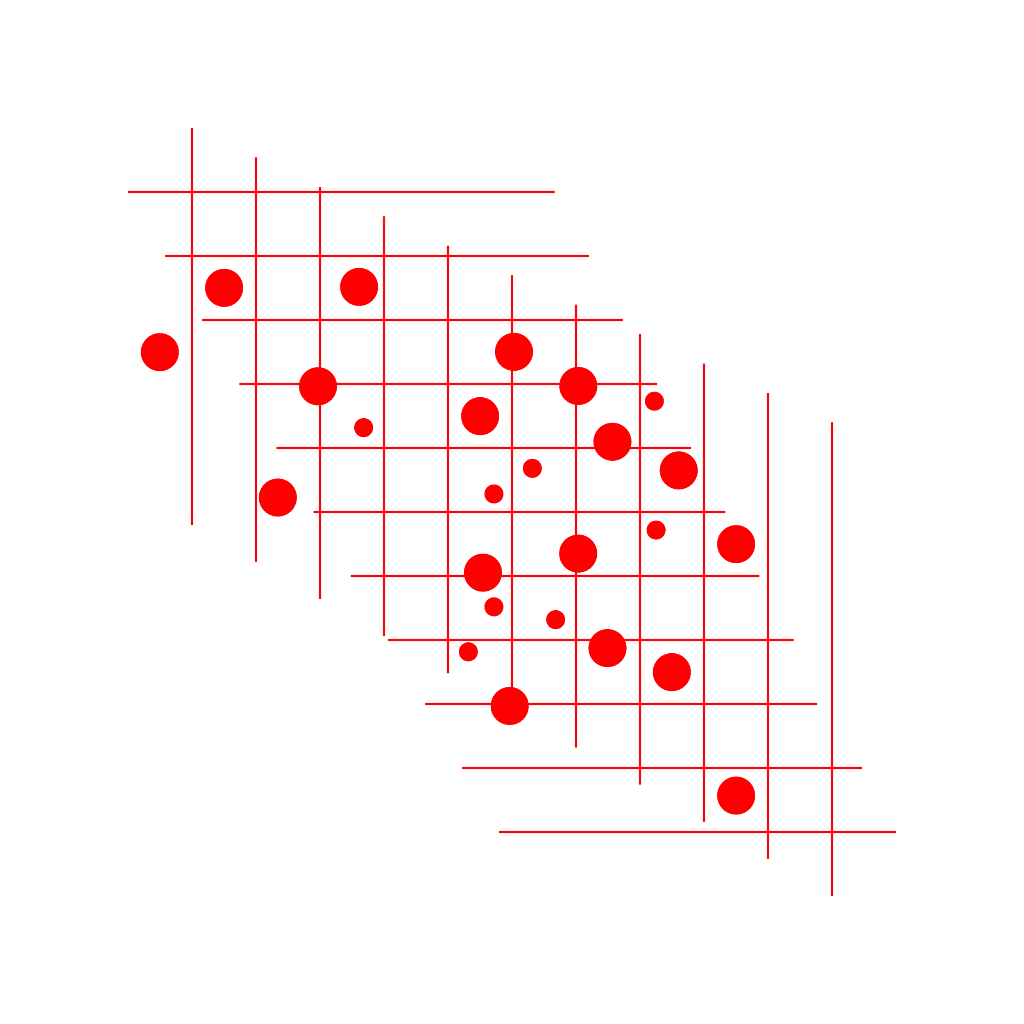
Scope and Commitments
VSU is part of a cohort.
  BranchED provides a community of institutions with shared goals where cohort institutions can access resources, professional development, and learn from each other so that we can sustainability produce and support diverse, highly-qualified teachers.
Sustainable Redesign Across All Programs and Partner Districts: Teacher Pipeline
  VSU and Valdosta City Schools are committing to demonstrate evidence of a sustainable redesign that is implemented to scale across all programs and partner districts with the goal of developing a diverse and highly effective teacher pipeline prepared with strategies to address racial, ethnic, linguistic, and other learning needs in P-12 students.
Notes:
VSU is part of a cohort. BranchED provides a community of institutions with shared goals where cohort institutions can access resources, professional development, and learn from each other so that we can sustainability produce and support diverse, highly-qualified teachers.
VSU and Valdosta City Schools are committing to demonstrate evidence of a sustainable redesign that is implemented to scale across all programs and partner districts with the goal of developing a diverse and highly effective teacher pipeline prepared with strategies to address racial, ethnic, linguistic, and other learning needs in P-12 students.
Changes need to be sustainable after 3 years for all 16 initial teacher certification programs at VSU:
Art Education (BFA), Healthcare Science Technology Education (Cert Only), Career and Technical Specializations (Cert Only), Elementary Education (BSEd), English to Speakers of Other Languages (MAT), Foreign Language Education (MAT), Health & Physical Education (BSEd & MAT), Middle Grades Education (BSEd & MAT), Music Education (MAT), Secondary Education (BA, BSEd & MAT), Special Education (MAT)

Slide 4

Transformation Assessment Tool
Not Yet Started “Haven’t begun” | Developing “Planning for it” | Emerging “Working on it” | Sustaining “Living it” | Transformational “Shifting the paradigm”
Elements of the indicator are not yet evident in the EPP. | Elements of the indicator are not evident, but implementation is in early development stage. “We are working on …” Talking about it Identifying needs Building background knowledge Collecting input Building consensus Dismantling barriers Planning actions Answering questions Designing the infrastructure | Implementation is evident, but elements of the indicator need further development/execution. “We are working on …” Putting plans into action Monitoring Reviewing and revising Working on policies, structures, and cultural conditions for full implementation | Full implementation is supported by strong evidence. “We are working on …” Establishing process and routine structures to ensure consistent implementation and fidelity Getting to scale – moving beyond isolated implementation toward widespread execution | Continual innovation is leading to transformation. “We are working on …” Not only sustaining but innovating, disrupting, thinking outside the box Using evidence for continuous improvement
The goal at the end of year three is to reach “Sustaining” for all 48 indicators.

Slide 5

Scope and Commitments
Changes need to be sustainable after 3 years for all 16 initial teacher certification programs at VSU:
Initial Certification Programs at VSU
Art Education (BFA) | Health & Physical Education (BSEd & MAT)
Career and Technical Specializations (Cert Only) | Middle Grades Education (BSEd & MAT)
Elementary Education (BSEd-Online and Face-to-Face) | Music Education (MAT)
English to Speakers of Other Languages (MAT) | Secondary Education (BA, BSEd & MAT)
Foreign Language Education (MAT) | Special Education (MAT)
Healthcare Science Technology Education (Cert Only)
Notes:
VSU is part of a cohort. BranchED provides a community of institutions with shared goals where cohort institutions can access resources, professional development, and learn from each other so that we can sustainability produce and support diverse, highly-qualified teachers.
VSU and Valdosta City Schools are committing to demonstrate evidence of a sustainable redesign that is implemented to scale across all programs and partner districts with the goal of developing a diverse and highly effective teacher pipeline prepared with strategies to address racial, ethnic, linguistic, and other learning needs in P-12 students.
Changes need to be sustainable after 3 years for all 16 initial teacher certification programs at VSU:
Art Education (BFA), Healthcare Science Technology Education (Cert Only), Career and Technical Specializations (Cert Only), Elementary Education (BSEd), English to Speakers of Other Languages (MAT), Foreign Language Education (MAT), Health & Physical Education (BSEd & MAT), Middle Grades Education (BSEd & MAT), Music Education (MAT), Secondary Education (BA, BSEd & MAT), Special Education (MAT)

Slide 6

Overview of Year 1 Goals
Develop a group of key stakeholders who reflect the demographics of the VSU and VSC communities that can meet consistently and evaluate a variety of aspects of teacher training and evaluation.
Identify common understandings of teacher competencies to meet the needs of students from diverse backgrounds.
Evaluate current practices for clinical experiences, to include candidate performance assessment tools and mentor onboarding.
Evaluate objectives/coursework for teacher preparation programs.
Evaluate tools/procedures for jointly gathering and analyzing data to support continuous improvement.
Evaluate potential bias in teacher evaluations and ways to reduce bias.
Develop a plan for systematic and sustainable professional development.
Identify current hiring needs, recruitment plans, and develop ways to attract and retain higher quality teachers.
Evaluate direct and indirect program costs for teacher candidates.
Evaluate teacher candidates’ self-efficacy, dispositions, and competencies and develop programs to track process across program and teaching.

Slide 7




How is this all getting done?
Five thought groups will meet monthly (except summer)
  Three reps from VCS & three from VSU in each group
  Each group has a charge for the year and is led by a Grant Leader
16 VSU program leaders will meet monthly to evaluate and revise curriculum
VSU faculty & VCS teacher professional development trainings
  Every summer with 80-person capacity
  Capacity of 16 VCS school leader attendees
  Half-day and occurs twice per year
Ongoing supervisor/mentor onboarding trainings and calibrations
Notes:
Everyone involved in these groups and trainings will receive a small stipend.

Slide 8

Get Involved and Engaged!
Feedback Prompts #1:
What do you hope to see change at VSU as an outcome of this grant?
What are some aspects that excite you about this grant?
Link for feedback: https://tinyurl.com/LaunchFB1
Feedback Prompts #2:
What are some barriers you foresee in these efforts, and how might we ameliorate the barriers?
Link for feedback: https://tinyurl.com/LaunchFB2
Notes:
For this grant to be successful, we need you to participate. Please feel free to reach out to a grant contact if you are interested in participating.
Jamboard directions

Slide 9
Grant Leadership Team
Elizabeth Lisic
Sedef Smith
David Slykhuis
Natalie Kuhlmann
Kristy Litster
Regina L. Suriel
Forrest Parker
David Cole
April Doyle
Joyce Dean
Alex Alvarez
Royce Thomas
LaConya McCrae

